Slide 1
Image processing

Slide 2
Acquiring knowledge for image processing

Slide 3
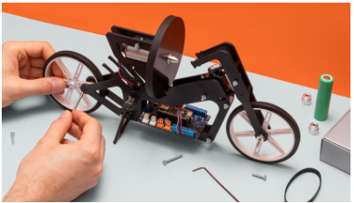
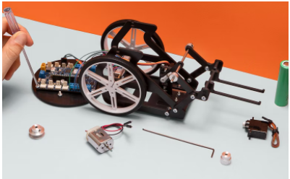
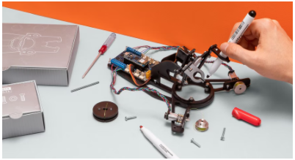
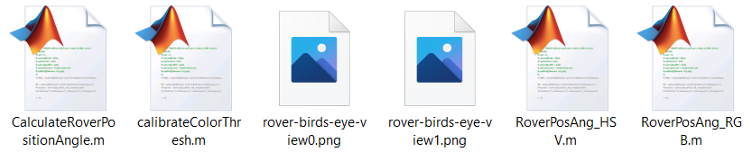
Introduction
Competencies
Image processing
Learning with Arduino Engineering Kits…
SELF-BALANCING MOTORCYCLE
WEBCAM CONTROLLED ROVER
DRAWING ROBOT
Required files:

Slide 4
Fundamentals
1

Slide 5
Digital images
1.1

Slide 6
Defining a digital image
An image is defined as a two-dimensional function f(x,y) where x and y are the coordinates of a plane containing all the points of the plane, and f(x,y) is the amplitude at the point (x,y) which is called intensity.
One of the most important parameters in a digital image is its resolution and the quality of an image depends directly on its resolution.
A digital image is composed of a finite number of elements, and each has a particular locality and value.

Slide 7
Color image
A color image is described and coded according to the color space used (RGB, ). For the RGB color space, mostly used to represent images, each pixel is presented as a set of certain amounts of red, green, and blue colors, making a matrix of three intensity levels, one for each color component.

Slide 8
Color image
Depending on the intensity value of each component, the color of the pixel will be one or the other.
The white color is composed of the maximum intensity of the three components
The different colors vary depending on the different intensities of the three components
The black color is composed of the
minimum intensity of the three components

Slide 9



Propiedades del color
Hue:
The hue is the frequency of the color spectrum or the dominant chromatic value.
Luminosity:
Luminosity is the mixture of colors with white or black with hue. Represents the amount of light present in a color. The higher the luminosity or the greater the amount of light, the color is configured with a greater mixture of white.
Saturation:
Saturation is the degree of purity of a color and is measured relative to gray. The lower the saturation, the color is more sour, more impure and with less light intensity.

Slide 10
Color spaces
1.2
Different models for color representation

Slide 11
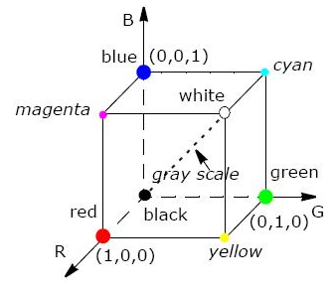
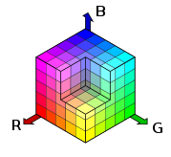
The RGB model
The acronym RGB stands for the red, green, and blue components. The RGB model is commonly used in the computer science field. The pixels that make up the screens are based on this model. For a scale from 0 to 1 each color is represented in three components (R, G, B) and is easily explained with the following cube.
See the diagonal produced between the colors black and white, which represents the range of grays. Each point on this diagonal is characterized by having the same amount of each component or primary color.

Slide 12
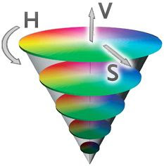
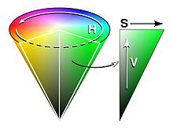
The HSV model
The acronyms H, S and V correspond to hue, saturation and value. This set of properties is graphically expressible with a cone, such that:
The brightest colors (V) are located at the base and the black color is located at the vertex of the cone.
To measure pitch or H an angle around the S axis is used:
Red 0º, green 120º and blue 240º
Saturation or S extends from the cone axis to darker colors.

Slide 13
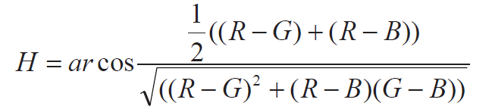
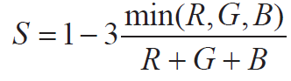
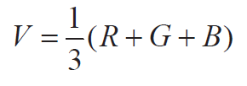
The HSV model
Values H, S, and V are obtained from the following relationships to RGB space:
The HSV space has the advantage of being unalterable to light conditions.

Slide 14
The YCbCr model
In the YCbCr model the color is represented by three parameters, the luminance (Y) and two different color values (Cb and Cr) as characteristics of the color:
Luminance is the amount of light and is directly proportional to physical intensity. Luminance is the weighting of the sensitivity of human perception with respect to the visible spectrum.
Cb and Cr are the components of blue differential chrominance and red differential.

Slide 15
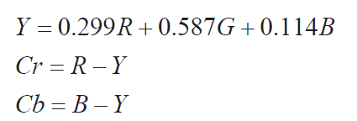
The YCbCr model
This model is used in image processing by concentrating most of the information in the luminance component.
In digital systems, its advantage is the saving of resources, bandwidth... by being able to compress the information with little loss of information. In contrast, vision algorithms do not usually provide a clear advantage.

Slide 16
Image analysis and processing
1.3

Slide 17
Before we begin...
Saturation is one of the most important properties of the field of image processing. Depending on the saturation the colors can be difficult to distinguish and as their saturation decreases, different color spaces will be used to optimize the detection algorithms.
Difficulty distinguishing color
Saturation

Slide 18
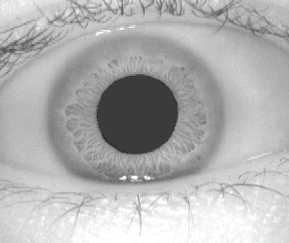
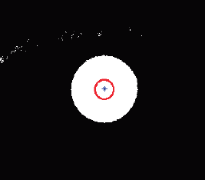
Image analysis and processing
The analysis includes techniques whose objective is to find and interpret the information contained in an image. In an image analysis system, it is understood that as input an image is available and as a result numerical values are obtained. To achieve a result, you need to go through different steps, such as processing and filtering, and it will always be tied to the problem you want to address.
Digitalization
Image enhancement
Segmentation

Slide 19
Image processing methods: families
Algorithms in the spatial domain:
Pixel-by-pixel processing. Processing the set of neighboring pixels.
Algorithms in the frequency domain:
Application of coefficients resulting from the Fourier transform.
Feature extraction algorithms:
Extracting attributes and regions.
Separating objects from the background.
Edge detection, shapes…

Slide 20
Image processing methods: techniques
Algorithms in the spatial domain:
Point, local, global, and geometric transformations
Smoothing Transformations Profiling Transformations
Edge detection Nonlinear transformations
Morphological operations
Algorithms in the frequency domain:
Transformation in the Fourier domain. Histogram-based transformation.
Feature extraction algorithms:
Segmentation. Tagging pixel groupings.

Slide 21
Case in practice
2
Webcam controlled rover

Slide 22
Introduction of the robot
2.1

Slide 23
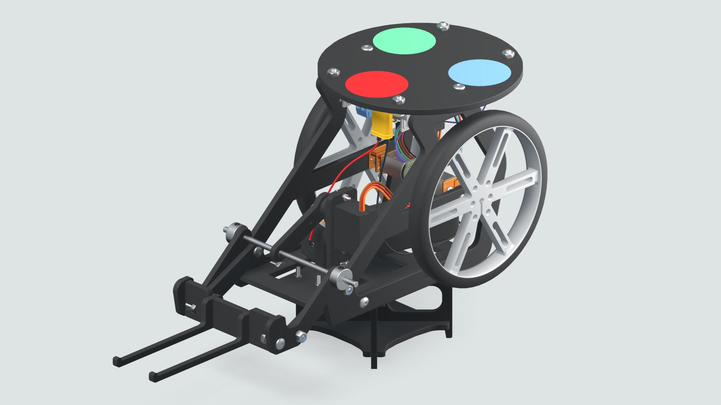

Webcam Controlled Rover
The webcam-controlled rover is about a programmable robot that with the help of an image processing algorithm can be targeted.
A colour-coded sticker will be installed on top of the rover, which will serve as a marker that will help the image processing algorithm and its webcam detect the robot's location and orientation.

Slide 24
Working with Matlab/Simulink
2.2

Slide 25


Control the position and direction of the rover
As the rover moves it is necessary to know its location. Using a webcam you can get at all times photographs will run a location algorithm:
Location calculation (x,y)
Rover direction calculation (angle).
Movement shall be restricted to an area which is designated and which shall be designated as a field.

Slide 26
Controlar la posición y dirección del rover
Environment creation and calibration
Runtime
Generate Field
Generate Orthogonal View
Calibrate color threshold
Calibrate rover position
Get Photo
Transform Orthogonal View
Calculate position and direction
Calculate new destination
Run Target

Slide 27
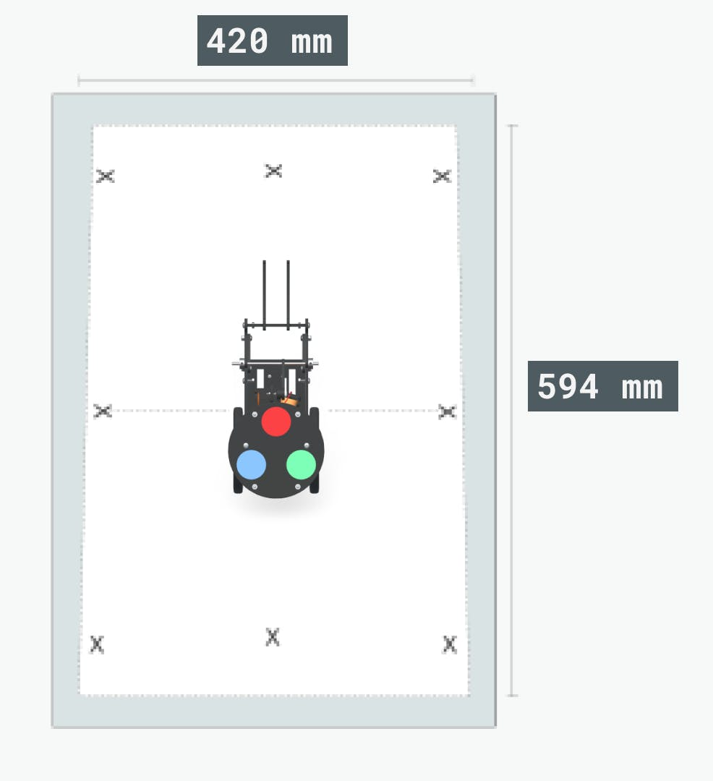
Generating the field
Requirements:
Field with white background
Place the camera at 100cm(min)
The integer field must enter the image

Slide 28
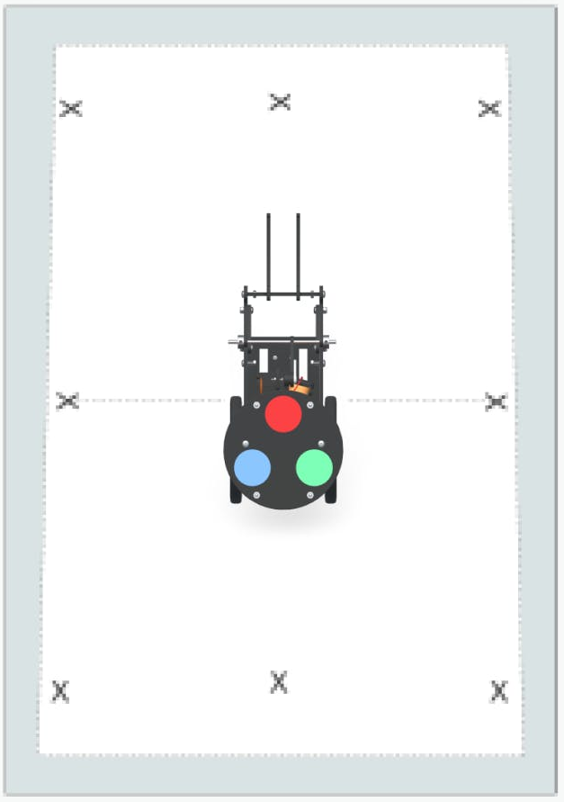
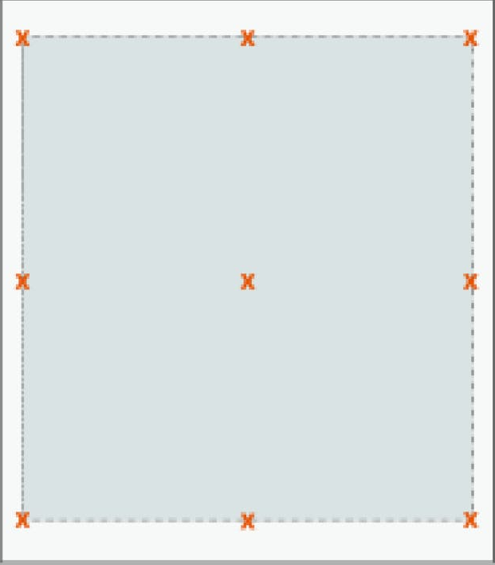
Orthogonal view transformation
Problem:
When placing a webcam on top of the field there is some difficulty in achieving an ideal image of the field, so the image tends to form a trapezoid.
Solution:
Image processing will help convert the image to a corrected version. This will make it easier for the location algorithm to calculate the position of the rover.

Slide 29
Transformación de la vista ortogonal
Measure the area
(height, width)
Measure 4 corners points
img = snapshot(cam);
calibrateOrthoView(img, h, w)
undistortImageFromRectangle(im,corners);
Save data
moveToRadians(theta,pidML,pidMR);

Slide 30
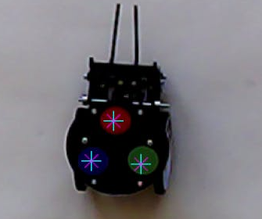
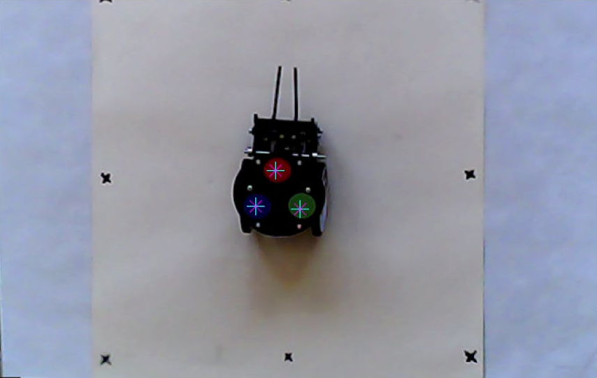
Calibrating color threshold
Obtaining the threshold for the respective RGB channels will allow in subsequent operations to find the centroids of the circular plate. The color of each selected pixel is saved for subsequent operations.
function calibrateColorThresh(...)

Slide 31
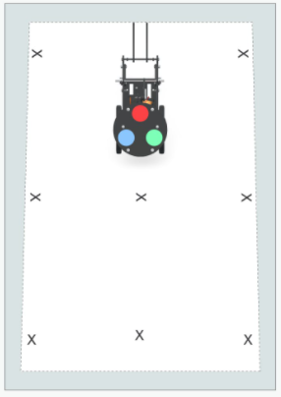
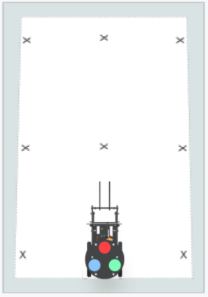
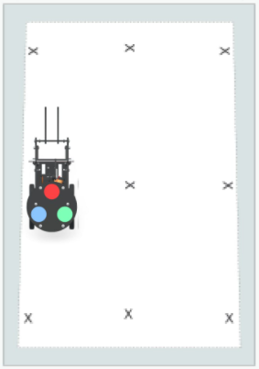
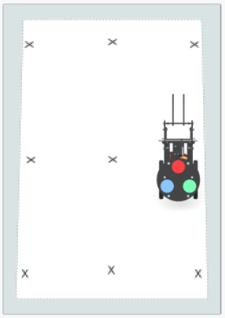
Calibrating the rover
When translating the image into orthogonal view, some distortion is generated due to the angle between the camera and the field. To compensate for this, images of the rover need to be captured on all four edges of the field.
Function calibrateLocationOffset(...)

Slide 32
Locating the rover
Once the calibration is complete, both the location of the rover and its address can be located. Image processing uses the RGB color space to perform the necessary calculations.
Separate RGB channels from the threshold of each color obtained in calibration
Remove small impurities or annoying little circles
Function roverPosAng (...)
Find the centroids of the 3 colors of the disc
Convert position (x,y) And angle to cm

Slide 33
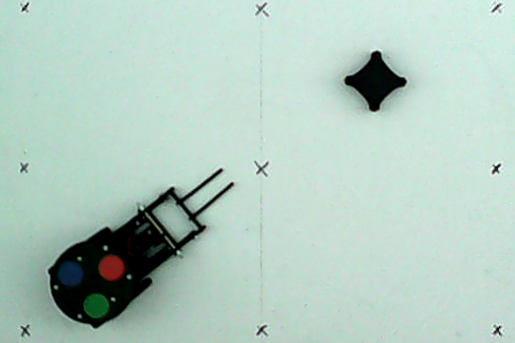
Positioning and angle of the robot
Exercise proposal:
Executes the Script “Calculate Rover Position & Angle” to calculate the position and angle of the robot. Using two color spaces, we can arrive at the same result. You have several images at your disposal to try different scenarios with light.
Remember that the HSV space has the advantage of being unalterable to light conditions.

Slide 34
Eskerrik asko
Muchas gracias
Thank you
Loramendi, 4. Apartado 23
20500 Arrasate – Mondragon
T. 943 71 21 85
info@mondragon.edu

